Slide 1
Software Testing and Quality Assurance
Theory and Practice
Chapter 18
Maturity Models
Notes:
Handouts
------------------------------------------------------------------
------------------------------------------------------------------
-------------------------------------------------------------------
--------------------------------------------------------------------

Slide 2
Outline of the Chapter
Basic Idea in Software Process
Capability Maturity Model (CMM)
Test Process Improvement (TPI)
Testing Maturity Model (TMM)
Summary

Slide 3
Basic Idea in Software Process
A process comprises a set of activities that are executed to develop products.
  The activities find expressions in the form of methods, techniques, strategies, procedures, and practices.
  The activities heavily rely on information repositories, such as documents, standards, and policies.
Different processes are driven by different goals and availability of resources.
It is useful to follow a defined process because of the following benefits.
  The process can be repeated in subsequent projects.
  The process can be evaluated by using a variety of metrics, such as cost, quality, and time to deliver.
  Actions can be taken to improve the process to achieve better results.

Slide 4
Basic Idea in Software Process
A software process comprises the following tasks.
  Gathering requirements
  Constructing a functional specification
  Designing the system
  Writing code
  Testing the system
  Maintaining the system

Slide 5
Basic Idea in Software Process
Software testing is treated as a distinct process because it involves a variety of unique activities, techniques, strategies, and policies.
  Testing is performed to reveal defects and show to what extent the software possesses different quality attributes, such as reliability and performance.
  Testing begins almost at the same time a project is conceptualized.
  Testing is carried out by different people at different stages of system development.
  A number of different techniques can be applied at each level of testing.
  A number of different strategies can be applied at each level of testing.
  A number of metrics can be monitored to gauge the progress of testing.
  Testing is influenced by organizational policies.
  Testing can be performed as a combination of manual and automated modes of execution of test cases.

Slide 6
Basic Idea in Software Process
To be able to improve a defined process, organizations need to evaluate its capabilities and limitations.
  Example: The Capability Maturity Model (CMM) allows an organization to evaluate its software development processes.
    The CMM model supports incremental process improvement.
A separate model, known as the Testing Maturity Model (TMM), has been developed to evaluate a testing process.
For an organization to be able to improve their testing process, the Test Process Improvement (TPI) model has been developed.

Slide 7
Capability Maturity Model (CMM)
While awarding a contract, the customer needs to gain confidence that an organization is capable of delivering the desired product.
The US Department of Defense wanted to evaluate their contractors.
  They needed a framework to evaluate the maturity of software processes.
  In 1986, the Software Engineering Institute (SEI) initiated the development of a framework to be called the CMM.
In the CMM model, the maturity level of an organization tells us to what extent an organization can produce low cost, high quality software.
Having known the current maturity level, an organization can work to reach the next higher level.
  There are five maturity levels in the CMM model.

Slide 8
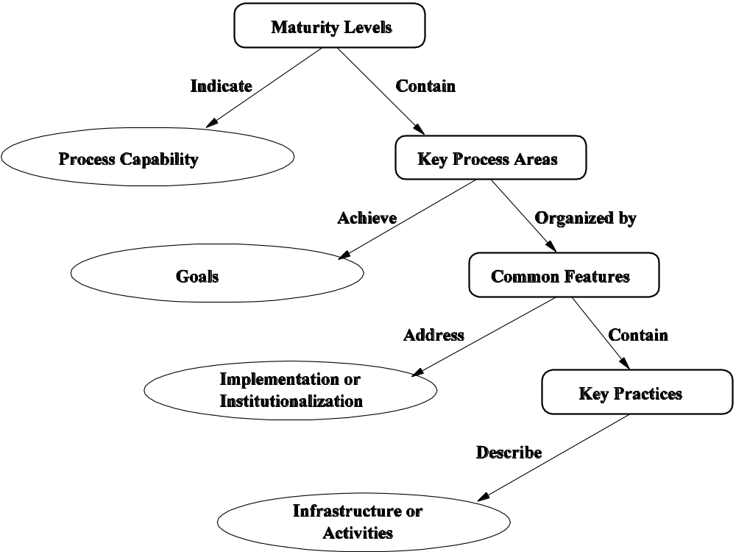
Capability Maturity Model (CMM)
Figure 18.1: The CMM structure [4] (©[2005] John Wiley).

Slide 9
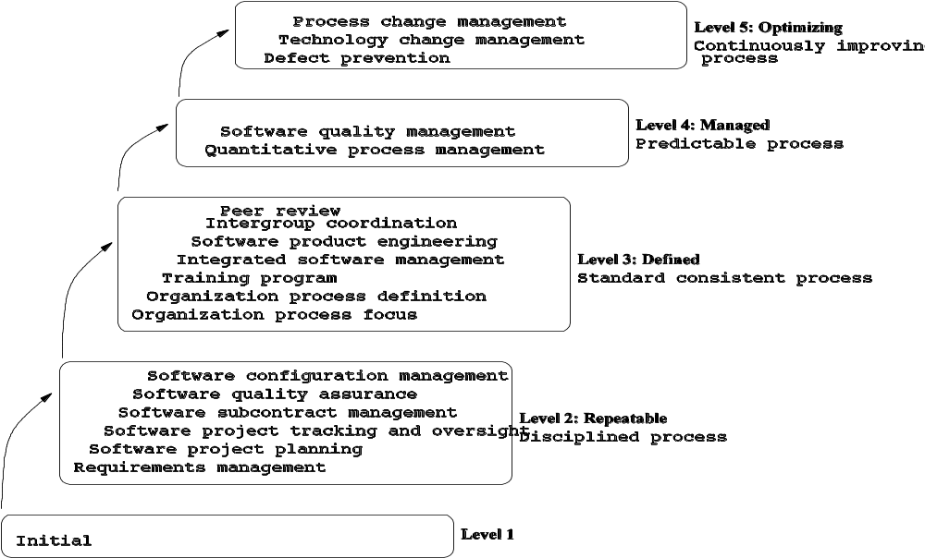
Capability Maturity Model (CMM)
Figure 18.2: SW-CMM maturity levels [4] (©[2005] John Wiley).

Slide 10
Capability Maturity Model (CMM)
Common features of key practices
  The key practices in every key process area are organized into five categories called common features.
  Common features are attributes of key practices that indicate whether the implementation of a KPA is effective, repeatable, and lasting.
The five categories of common features are as follows.
  Commitment to perform
  Ability to perform
  Activities performed
  Measurement and analysis
  Verifying implementation

Slide 11
Capability Maturity Model (CMM)
Application of the CMM
  For an organization to be at a certain level of maturity, all the goals of all the KPAs at that level – and all preceding levels too – must be satisfied.
    Example: For an organization to be at Level 3, it must meet all the six KPAs at Level 2 and all the seven KPAs at Level 3.
  The SEI developed the Capability Maturity Model-Based Assessment Internal Process Improvement (CBA-IPI) to assist organizations for self-assessment.
    The CBA-IPI uses the CMM as a reference model to evaluate the process capability of organizations by identifying what KPAs are being satisfied and what need to be improved.
  The SEI developed the CMM Appraisal Framework (CAF) to provide a mechanism for formal evaluation of organizations.
    The CAF describes the requirements and guidelines to be used by external assessors in designing CAF-compliant evaluation methods.

Slide 12
Capability Maturity Model (CMM)
Capability Maturity Model Integration (CMMI)
  After the successful application of the CMM in the software area (known as CMM-SW). CMMs in other areas were also developed.
    Systems Engineering CMM
    Integrated Product Development CMM
    Electronic Industry Alliance 731 CMM
    Software Acquisition CMM
    People CMM
    Supplier Source CMM

Slide 13
Test Process Improvement (TPI)
A test process is a certain way of performing activities related to defect detection.
A few such activities are as follows (See Section 18.3 for more.)
  Identifying test goals.
  Preparing a test plan.
  Identifying different kinds of tests.
  Hiring test personnel.
  Designing test cases.
  Setting up test benches.
  Procuring test tools.
  Assigning test cases to test engineers.
  Prioritizing test cases for execution.
  Organizing the execution of test cases into multiple test cycles.

Slide 14
Test Process Improvement (TPI)
A simple test process for system-level testing
  Categorize the features of a system into k groups.
  Design N_{i} test cases for feature category i, for 1 ≤ i ≤ k. These N_{i} test cases are denoted by the set T_{i}.
  Run T₁ U … U T_{k} to detect defects.
  Run T₁ U … U T_{k} each defect fix until no more defects are found, or it is time to release the system.
Deficiencies in the above simple process.
  Test tools have not been used.
  Test cases have not been prioritized.
  The entire test suite has been executed in each test cycle.
Therefore, it is important to improve test processes by following a defined model.
  The idea of improving test processes by following a model, namely the Test Process Improvement (TPI) model, was first studied by Tim Koomen and Martin Pol.

Slide 15
Test Process Improvement (TPI)
A test process needs to be improved for three reasons.
  Quality: A better test process should give more insights into the quality characteristics of a system being tested.
  Lead Time: A better test process saves testing time.
    One can prioritize test cases so that difficult-to-fix defects to gain time.
  Cost: A better test process is expected to be carried out with a lower cost.
An intuitive approach to improving a test process is as follows:
  Step 1: Determine an area for improvement.
  Step 2: Evaluate the current status of the test process.
  Step 3: Identify the next desired state and the means.
  Step 4: Implement the necessary changes to the process.
The above steps are straightforward, but their implementation is not.
The TPI model supports gradual process improvement.
  The current status of a test process is evaluated from different viewpoints, known as key areas – and 20 key areas have been identified.
  The status of a test process w.r.t. a key area is represented in terms of one of four levels of maturity – A, B, C, and D.

Slide 16
Test Process Improvement (TPI)
The 20 key areas are as follows:
  Test strategy
  Life-cycle model
  Moment of involvement
  Planning and estimating
  Test specification technique
  Static test technique
  Metrics
  Test tools
  Test environment
  Office environment
  Commitment and motivation
  Test functions and training
  Scope of methodology
  Communication
  Reporting
  Defect management
  Test process management
  Evaluation
  Low-level testing

Slide 17
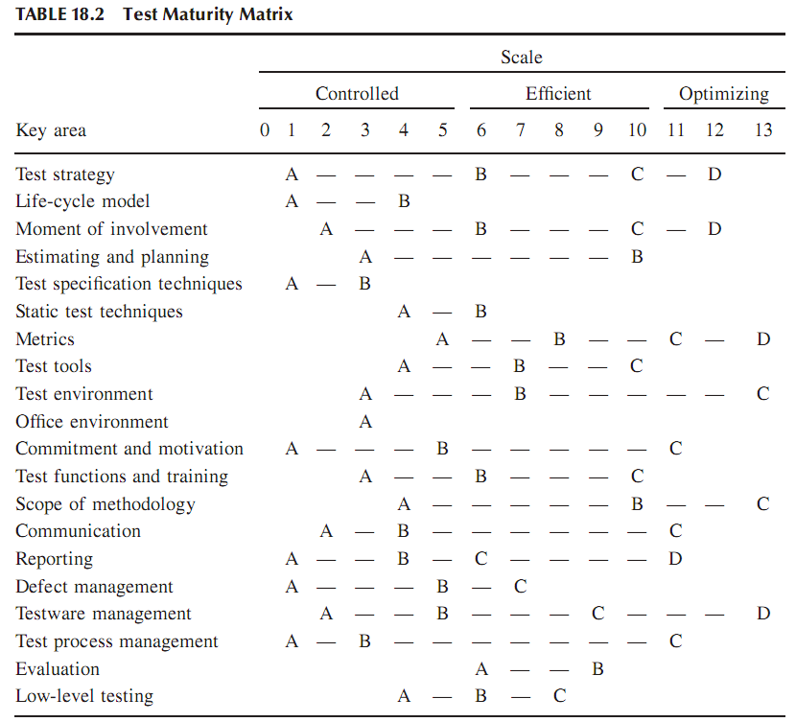

Slide 18
Test Process Improvement (TPI)
Maturity levels of test processes
  Based on the idea of dependencies and prioritization, a Test Maturity Matrix, as shown in Table 18.2, is constructed.
  The Test Maturity Matrix shows that the overall maturity of a test process can be represented on a scale of 1—13.
  The 13 scales of maturity of a test process are classified into three distinct segments as follows.
    Controlled (1—5): All component activities are planned and executed in phases according to the plan.
    Efficient (6—10): All the key areas, except Evaluation, are raised to at least B level with some being at C.
    Optimizing (11—13): All the key areas have reached their respective highest maturity levels.
      Optimizing a test process means performing testing tasks in the best possible manner from the standpoint of quality, time, and cost.

Slide 19
Test Process Improvement (TPI)
Applying the TPI model
  Analyze the current test process, using Table 18.1 (Requirements for different maturity levels), in terms of the 20 key areas, and give each key area a rating – A, B, C, or D.
  Evaluate the current scale, between 1—13, of the test process by comparing the current status of the test process with the standard Test Maturity Matrix of Table 18.2 (Test maturity matrix.)
  Identify the goal of the organization in terms of the next scale to be achieved. Identify the key areas where improvements must be achieved.
  Take actions to improve the key areas identified in the preceding step.

Slide 20
Testing Maturity Model (TMM)
TMM was pioneered by Ilene Burnstein to help organizations evaluate and improve their testing processes.
The TMM framework describes an evolutionary path of test process maturity in five levels, or stages. (Figure 18.3).
Each stage is characterized by the concepts of
  maturity goals
  supporting maturity goals, and
  activities, tasks, and responsibilities (ATRs)

Slide 21
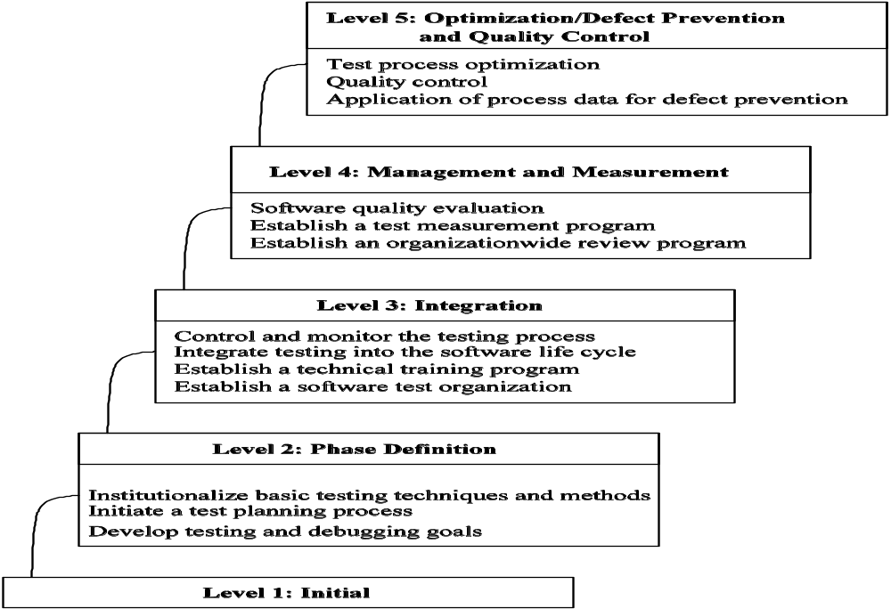
Testing Maturity Model (TMM)
Figure 18.3: The 5-level structure of the testing maturity model [1] (©[2003] Springer).

Slide 22
Testing Maturity Model (TMM)
Maturity goals
  Each maturity level, except 1, contains certain maturity goals.
  For an organization to reach a certain level, the corresponding maturity goals must be met by the organization.
Maturity subgoals
  Maturity goals are supported by maturity subgoals
ATRs (Activities, Tasks and Responsibilites)
  Maturity subgoals are achieved by means of ATRs.
  ATRs address issues concerning implementation of activities and tasks.
  ATRs also address how an organization can adapt its practices so that it can move in-line with the TMM model.
  ATRs are refined into “views” from the perspectives of three groups:
    Managers
    Developers and test engineers
    Customers (user/client).

Slide 23
Testing Maturity Model (TMM)
Level 1 – Initial
  There are no maturity goals to be met at this level.
  Testing begins after code is written.
  An organization performs testing to demonstrate that the system works.
  No serious effort is made to track the progress of testing.
  Test cases are designed and executed in an ad hoc manner.
  In summary, testing is not viewed as a critical, distinct phase in software development.

Slide 24
Testing Maturity Model (TMM)
Level 2 – Phase Definition: The maturity goals are as follows:
  Develop testing and debugging goals.
    Some concrete maturity subgoals that can support this goal are as follows:
      Organizations form committees on testing and debugging.
      The committees develop and document testing and debugging goals.
  Initiate a test planning process. (Identify test objectives. Analyze risks. Devise strategies. Develop test specifications. Allocate resources.)
    Some concrete maturity subgoals that can support this goal are as follows:
      Assign the task of test planning to a committee.
      The committee develops a test plan template.
      Proper tools are used to create and manage test plans.
      Provisions are put in place so that customer needs constitute a part of the test plan.
  Institutionalize basic testing techniques and methods.
    The following concrete subgoals support the above maturity subgoal.
      An expert group recommends a set of basic testing techniques and methods.
      The management establishes policies to execute the recommendations.

Slide 25
Testing Maturity Model (TMM)
Level 3 – Integration: The maturity goals are as follows:
  Establish a software test group.
    Concrete subgoals to support the above are:
      An organization-wide test group is formed with leadership, support, and $$.
      The test group is involved in all stages of the software development.
      Trained and motivated test engineers are assigned to the group.
      The test group communicates with the customers.
  Establish a technical training program.
  Integrate testing into the software lifecycle.
    Concrete subgoals to support the above are:
      The test phase is partitined into several activities: unit, integration, system, and acceptance testing.
      Follow the V-model.
  Control and monitor the testing process.
    Concrete subgoals to support the above are:
      Develop policies and mechanisms to monitor and control test projects.
      Define a set of metrics related to the test project.
      Be prepared with a contingency plan.

Slide 26
Testing Maturity Model (TMM)
Level 4 – Management and Measurement: The maturity goals are:
  Establish an organization-wide review program.
    Maturity subgoals to support the above are as follows.
      The management develops review policies.
      The test group develops goals, plans, procedures, and recording mechanisms for carrying out reviews.
      Members of the test group are trained to be effective.
  Establish a test management program.
    Maturity subgoals to support the above are as follows.
      Test metrics should be identified along with their goals.
      A test measurement plan is developed for data collection and analysis.
      An action plan should be developed to achieve process improvement.
  Evaluate software quality.
    Maturity subgoals to support the above are as follows.
      The organization defines quality attributes and quality goals for products.
      The management develops policies and mechanisms to collect test metrics to support the quality goals.

Slide 27
Testing Maturity Model (TMM)
Level 5 –Optimization, Defect Prevention and Quality Control: The maturity goals are as follows:
  Application of process data for defect prevention
    Maturity subgoals to support the above are as follows.
      Establish a defect prevention team.
      Document defects that have been identified and removed.
      Each defect is analyzed to get to its root cause.
      Develop an action plan to eliminate recurrence of common defects.
  Statistical quality control
    Maturity subgoals to support the above are as follows.
      Establish high-level measurable quality goals. (Ex. Test case execution rate, defect arrival rate, …)
      Ensure that the new quality goals form a part of the test plan.
      The test group is trained in statistical testing and analysis methods.
  Test process optimization
    Maturity subgoals to support the above are as follows.

Slide 28
Testing Maturity Model (TMM)
Level 5 –Optimization, Defect Prevention and Quality Control: The maturity goals are as follows (continued.)
  Test process optimization
    Maturity subgoals to support the above are as follows.
      Establish a test process improvement group to monitor the testing process and identify areas for improvement.
      Evaluate new technologies and tools to improve the capability of the testing process.
      Put a mechanism in place for continual evaluation of the effectiveness of the testing process.
      Test stopping criteria are based on quality goals.

Slide 29
Summary
Capability Maturity Model (CMM)
  The CMM is used to assess the maturity level of an organization to develop software products.
  Five levels of maturity
    Level 1: Initial
    Level 2: Repeatable
    Level 3: Defined
    Level 4: Managed
    Level 5: Optimized
  Each level is characterized by a set of key process areas.
Test Process Improvement (TPI)
  A test process is evaluated w.r.t. 20 key areas.
  The maturity level of a test process is assessed on a scale of 1—13.
  The 13 levels of maturity are partitioned into three groups: controlled, efficient, and optimizing.
Testing Maturity Model (TMM)
  The TMM model gives guidelines concerning how to improve a test process.
  The maturity of a testing process is evaluated on a scale of 1—5.
    Level 1: Initial
    Level 2: Phase Definition
    Level 3: Integration
    Level 4: Management and Measurement
    Level 5: Optimization, Defect Prevention, and Quality Control

